Slide 1
KS3 Curriculum Evening
Welcome
Lorraine Baker
Assistant Principal

Slide 2
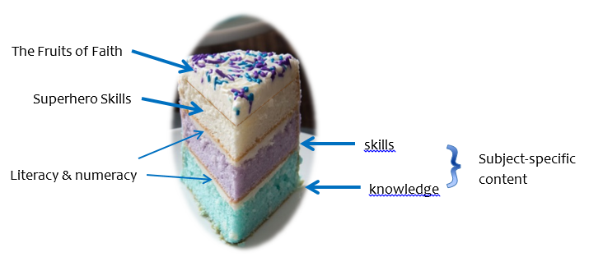
Love to Learn; Learn to Live; Live to Love

Slide 3
How does the KS3 curriculum change?
Main change from year KS2 to KS3 is the pace of the lessons and the breadth and depth of knowledge and the expectation that students are working more independently.
Language used in various subjects become more technical.
If your son/daughter was a 6S or 6M at the end of year 6 this doesn’t automatically mean they will convert to that stage straight away in year 7.

Slide 4
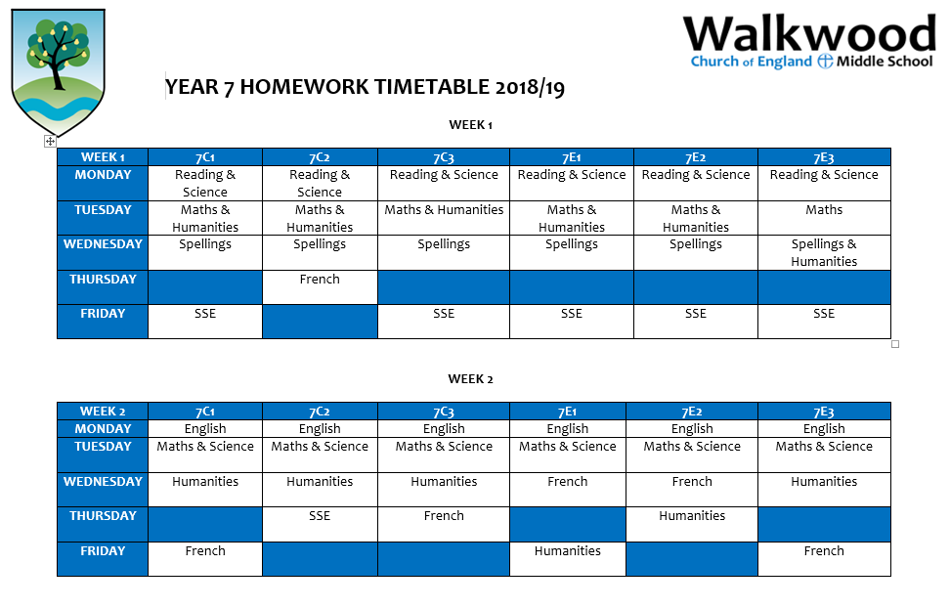
Homework Expectations
Changes within homework take place.
Now adding in French and SSE.
Higher expectations in managing their workload and time.

Slide 5
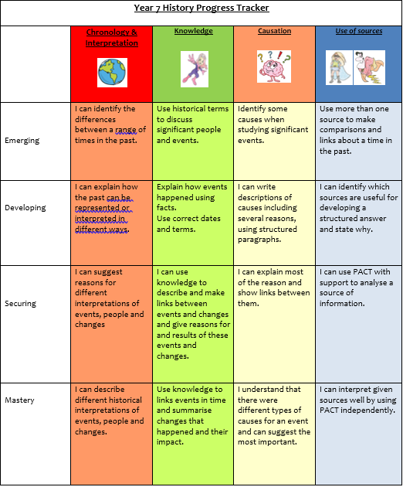
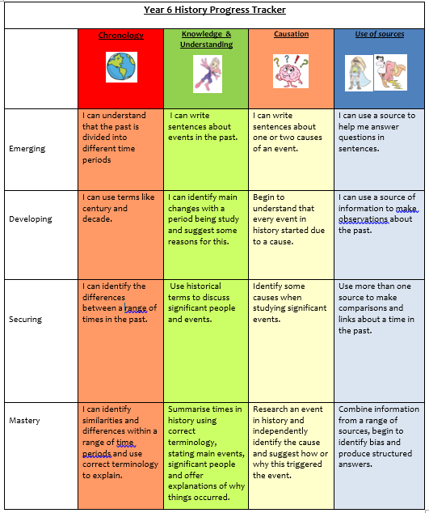
Stages and Scores
Learning journals used within all lessons. Expectations are higher to acquire the stages.

Slide 6
Role of a KS3 pupil
Become more independent!
Role model for KS2 pupils
Increased roles within VT time
Preparing to apply for leadership roles in Year 8.
Volunteering to help at clubs for KS2 pupils.
Responsible for homework and managing the demand of it.
Self Manager skills to be used at a secure or mastered level. Responsible for their own learning!

Slide 7
Subject Information
Science
Schemes of work support them through KS3 to GCSE success.
Broken down into the three elements of biology , chemistry and physics.
Each topic is designed to underpin the knowledge required for each GCSE topic in KS4.

Slide 8
Subject Information
Humanities
Topics change to old GCSE topics for example: Medicine through time and Desert climates.
Analysis of sources becomes more regular.
Assessment focus on the command words required to answer questions. Higher order thinking!
Independent studies: interpretations of sources and explanations.
Level of homework increases and expectations.

Slide 9
Subject Information
SSE
Topics reflect new GCSE spec, including exam skills and how to debate controversial ideas.
Looking at a mix of theology as well as philosophy
Example Theology: Role of the Trinity, why did Jesus have to die, religious beliefs and attitudes
Example Philosophy: If God exists, why is there suffering in the world? If God is omnipresent, why do we need to go to church?
Assessment focus on extended writing opportunities. Looking at different viewpoints.
Interpretation of scripture and how different people believe different things.
Level of expectation increases and use of technical language.
Greater emphasis on RSE

Slide 10
Subject Information
ICT
Pupils design, use and evaluate real-world problems and physical systems through the use of Microbits which are not used in KS2 due to their complex nature.
Students are taught to understand several key algorithms.
In KS3 the use of programming languages is enhanced.
Pupils are taught the inner workings of a computer looking at hardware and software components.
Pupils are taught to understand a range of ways to use technology safely, respectfully, responsibly and securely, including protecting their online identity and privacy; recognise inappropriate content, contact and conduct, and know how to report concerns.

Slide 11
Subject Information
Physical Education
Assessment criteria surrounding leadership, reflection, mind-set, fitness, character and decision making within their report cards pupils are looked at in more depth.
We also promote the use of more detailed subject specific language within lessons.
As the KS3 national curriculum builds on pupils to become more competent and confident in a range of PE activities.
There is also opportunity for leadership development within KS3 lessons and extra-curricular through helping at KS2 clubs, officiating college matches and the sports council.

Slide 12
As a parent…
You could promote your child’s independence at home which would benefit them in school. (Checking their epraise, planners, having the right equipment)
Encourage wider reading of the topics the pupils are studying from a variety of sources.
Encouraging them to take more responsibility for homework and behaviour.
Understand the stages and scores of your son/daughter so you know how to help at home by attending parents evenings.

Slide 13
How does the curriculum change from KS2 to KS3?
From SATs to AQA

Slide 14
The focus at Key Stage 2 is primarily on the technical side of English –SPaG.
This requires the pupil to have sound knowledge of concepts like word class, sentence structure, punctuation and spelling etc. which will prepare them for their end of KS2 test: SATs.

Slide 15
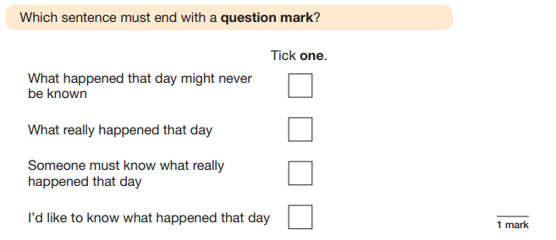
Typical questions on the Year 6 SATs SPaG paper look like this:

Slide 16
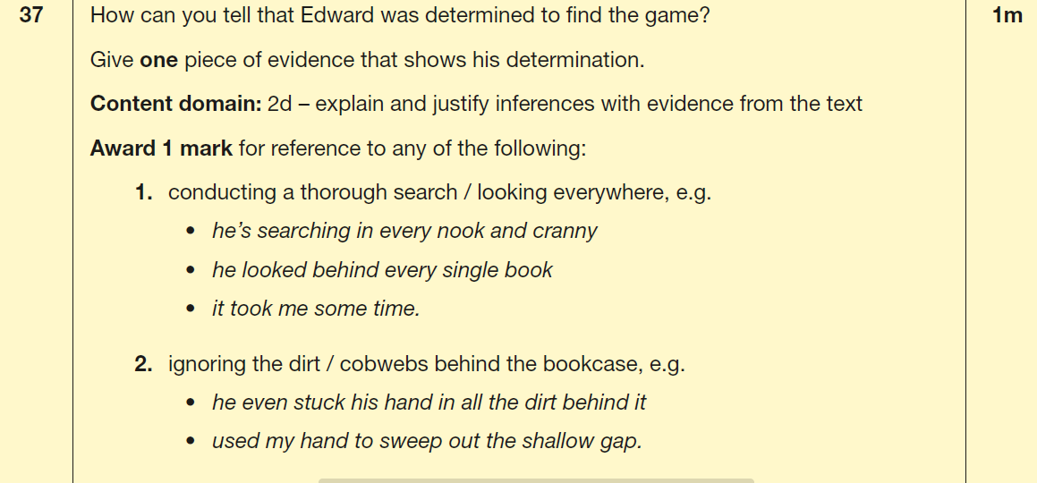
In reading at KS2, questions focus on locating and retrieving information and making inferences.

Slide 17
At Key Stage 3, the focus completely changes from the technical aspects of language and the more simple aspects of reading to the analysis of language (in reading) and writing for different purposes (in writing).
This prepares them for their end of KS3 test –
The AQA Test in Reading &Writing

Slide 18
In KS3, pupils are expected to consolidate their knowledge of grammar and vocabulary. They do this by:
Analysing more challenging texts
Studying the effectiveness of the grammatical features of the texts they read
Picking up new vocabulary and grammatical tools from the books and other texts they read, and using them in their own writing and speech
Understanding the differences between written and spoken English, including formal and informal registers, and Standard English
Using Standard English confidently and consistently in their written and spoken work
Using linguistic and literary terminology to discuss reading, writing and spoken language.

Slide 19
AQA Assessment
The assessment is divided into two sections (reading and writing).
Reading
The reading section focuses on a pupil’s ability to understand challenging texts and to critically analyse through making comparisons, studying plot and recognising literary techniques.
Reading response require the use of PEZE.
Writing (40 marks)
Writing focuses on the content and organisation of written work and the technical accuracy of a students work.

Slide 20
P E Z E
Point Evidence Zoom (analyse) Explain
The author uses hyperbole to emphasise Darren’s feelings. For example, in the text, it says, “I shut the window and fled to the safety of my bed”. The verb “fled” is particularly important as it implies that Darren was trying to run away or escape from a life or death situation. The reference to danger along side the mention of ‘safety’ shows the conflict within Darren’s own emotions. The authors use of exaggeration, whilst Darren is alone in his bedroom, creates a sense of fear for the reader. They become concerned that Darren and maybe even his family are in danger. The extract shows that although Darren is at home, during this time, he feels lonely as he discusses the difficulties of talking to his family. The feeling of dread and fear is then amplified by the mention of vampires attacking their home.

Slide 21
Reading
The ideal answer to this question will pick out the deliberate language used by the author and analyse it. Pupils will determine the types of words used (e.g. word classes – such as verbs, adjectives, adverbs etc.) and discuss how they work to convey the behaviour of the puppies. Pupils should also be able to identify linguistic features such as metaphors and similes and perform similar analysis. Ultimately, the literary techniques and language used in the extract will shape the response to the question. Students should always use PEZE to structure their response to ensure top marks.

Slide 22
Writing
Here, pupils need to identify the type of text they need to write and should include the appropriate text features.
The task requires a response of opinion. Pupils need to adopt a viewpoint (agree/disagree) and write in a way that explains this succinctly. They also need to match their register to the task – in this case, a fairly informal register that would reflect that it is a personal opinion on a website, which can be viewed by the general public.
This question is always out of a total of 40 marks with 24 marks being awarded for content & organisation (what is said and how it is organised) and 16 awarded for accuracy (use of ambitious vocabulary, accurate spelling & grammar, accurate sentence demarcation (punctuation) etc.).

Slide 23
What can you do to support
your children?
CGP books are great and cover everything your child will need to know at KS3 level.
There is also an online version which accompanies the book so you can read it on a tablet or MAC.
https://www.cgpbooks.co.uk/School/books_ks3_english.book_EHS36

Slide 24
What can you do to support
your children?
-Ensure your child completes their homework
and hands it in on time.
-Collaborate with teachers –raise any
concerns you have and contact us when
things begin to go awry.
-Check Epraise – know what homework
needs to be done when and for whom.
-Encourage them to read challenging books
and make sure they quiz regularly–
they will need to have exposure to higher-
level texts in order to understand test
material.
Help us to keep our standards high!
https://www.cgpbooks.co.uk/School/books_ks3_english.book_EHS36
ISBN 978 1 84762 156 6

Slide 25
Maths
How do things change from KS2 to KS3?

Slide 26
Sets
In year 6 the year group is split and in each half there are sets 1 – 3. In upper school, the whole year group is set in groups 1 - 6
Year 6
Year 7
set 1
set 1
7C and 7E
6C
set 2
set 2
set 3
set 3
set 4
set 1
6E
set 5
set 2
set 6
set 3

Slide 27
What's changed?
The focus changes more from arithmetic based.
Now the pupils will need to prove and solve questions
Pupils to use more reasoning skills.
For example:

Slide 28
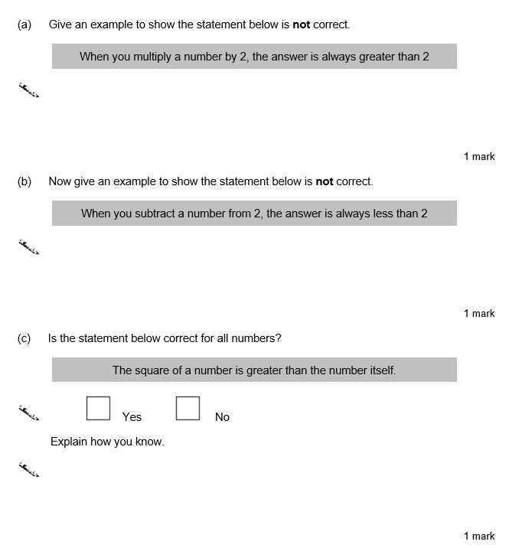

Slide 29
Ben sees these adverts to hire the same car.
Hire Deal
No charge for mileage
Normal price £78 each day
Offer Now 1/3 off
Price includes VAT Best Cars
£36 each day
15p for each mile
Prices exclude VAT
VAT is 20%
Ben wants to hire the car for 10 days.
He expects to drive 600 miles.
Should he choose Hire Deal or Best Cars to get the cheaper deal?
You must show your working.
..................................................................................................................................
..................................................................................................................................
..................................................................................................................................
..................................................................................................................................
..................................................................................................................................
..................................................................................................................................
Answer..................................
(Total 6 marks)
Here pupils need to work out the best value and use their workings to prove why/how their answer is correct

Slide 30
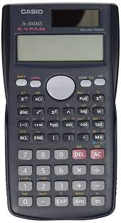
What's changed?
In KS3 pupils will use a calculator more and will sit papers that require them to use a calculator. Guidance on using a calculator effectively will be given.
Pupils having their own calculator is important so that they know how to use theirs effectively as this can vary between brands.
A scientific calculator is ideal, especially for
those pupils in the upper sets.

Slide 31
What's changed?
The biggest change is the introduction of algebra.
Pupils will focus on the basics first making sure they are secure so that they can tackle some of the more challenging concepts.

Slide 32
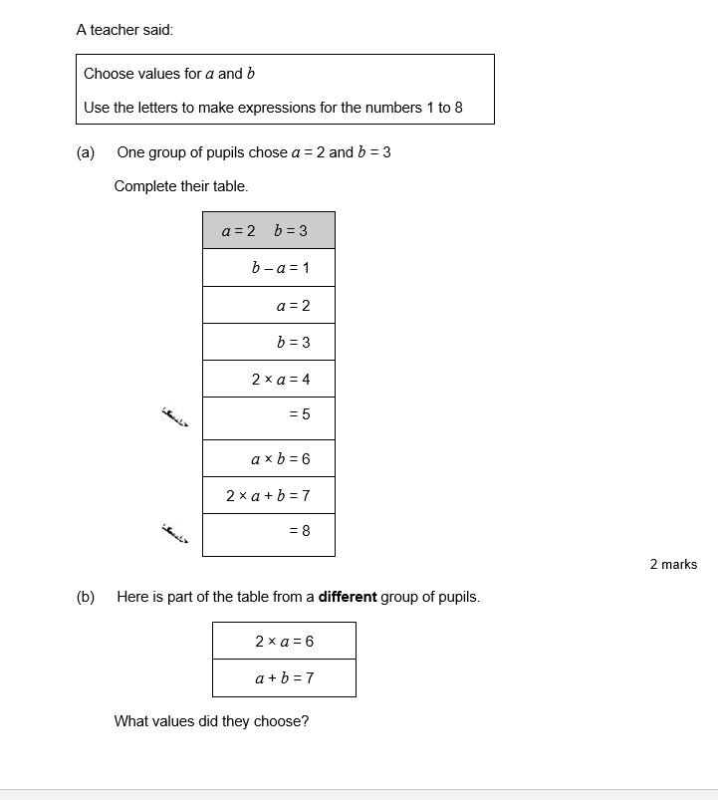

Slide 33
What's changed?
Our assessments have changed from KS2 standardised tests to assessments created from previous GCSE questions.
All of the questions (whilst coming from previous GCSE papers) are all based around the KS3 learning objectives.

Slide 34
Topic overview of the year
Autumn
Algebra 1 Describe patterns Construct formulae Solve simple equations Simplify expressions and expand brackets
Number 1 Add and subtract including decimals Estimate answers Multiply and divide by 10, 100, 1000 Add and subtract with positive and negative numbers Solve problems
Geometry and Measures 1 Name and draw 2D shapes Find area and perimeter od 2D shapes Use geometrical properties of 2D shapes Draw and construct 3D shapes Calculate the surface area of cuboids
Statistics 1 Collect data in a frequency table Read and interpret statistical diagrams Find the mean and median Interpret pie charts Calculate probability
Algebra 2 Recognise square and triangle numbers Find square roots using a calculator Generate co-ordinates from a linear rule Plot graphs from functions

Slide 35
Topic overview of the year
Spring
Number 2 Convert between fractions, decimals and % Add and subtract fractions Calculate % and fractions of an amount Use ratio and proportion
Geometry and measures 2 Read and plot co-ordinates Name and recognise angles Calculate missing angle
Statistics 2 Collect and record data, group where appropriate Compare 2 simple distributions Interpret graphs and diagrams
Algebra 3 Solve problems involving algebra Construct and use simple formulae Express problems algebraically

Slide 36
Topic overview of the year
Summer
Number and measures 3 BODMAS Round to nearest 10, 100, 1000 and I decimal place Solve problems involving measures Multiply and divide 3 digit by 2 digit numbers Estimate
Algebra 4 Solve equations Construct and use formulae Interpret co-ordinates from real-life situations Solve problems involving algebra
Number 4 Solve problems and present results in a clear and organised way Use simple % and fractions to describe proportions of a whole Calculate fractions and % of a quantity
Statistics 3 Understand and use the range to describe data Interpret pie charts Compare 2 distributions using mean and range then draw conclusions Calculate probabilities based on experimental evidence
Geometry and measures 3 Name triangles and quadrilateral Draw and measure lines and angles Construct triangles Rotate shapes and find order of rotational symmetry Translate shapes Identify all the symmetries of 2D shapes

Slide 37
Topic overview of the year
As you can see the topics are repeated over the year, this is so that pupils can reflect upon previous learning and build upon existing knowledge and skills as the year progresses.

Slide 38
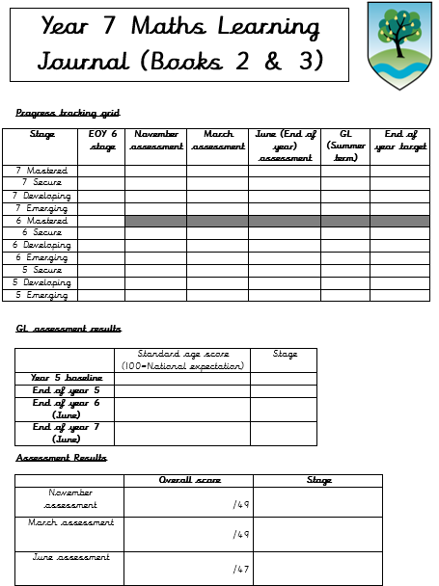
Learning Journals
In the front of pupil books they have a learning journal. This helps pupils to keep track of where they are and show the progress they are making throughout the year.

Slide 39
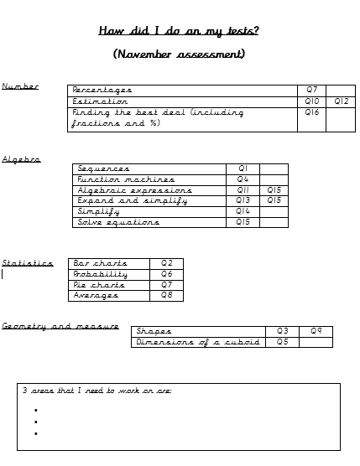
QLA sheets
We use the QLA (Question Level Analysis) sheets to help pupils identify areas of weakness after each assessment.

Slide 40
Using MyMaths to support areas of weakness
MyMaths is a helpful tool for pupils.
Once they have identified areas they need to work on, they can search MyMaths for help on those areas, using the search bar at the top right of the screen once pupils have logged on.
There is a huge range of topics covered at different levels.
https://www.mymaths.co.uk/

Slide 41
Useful books and websites
MyMaths
Maths is fun
Transum
Youtube
CGP books aimed at KS3

